Slide 1



NETFLIX
WWW.NETFLIX.COM
PRESENTED BY
KIRUBAKARAN V
01

Slide 2


Aim ?
TO CLEAN, ANALYZE AND EXPLORE DATA ABOUT THE TITLES AVAILABLE ON NETFLIX (BOTH MOVIES AND TV SHOWS)
WHAT WE ANALYZE?
MOIVES VS TV SHOWS (DISTRIBUTION & GROWTH)
POPULAR GENRES, RATINGS, AND COUNTRIES
CONTENT AGE, RELEASE TRENDS, AND DURATION
STATISTICAL TESTS TO COMPARE GROUPS
02

Slide 3

OBJECTIVE
Total Records
8,807 entries (Movies + TV Shows)
4,307 Null values in the given dataset
Attributes
Type (Movie or TV Show)
Title
Director
Cast
Country
Date Added
Release Year
Rating
Duration
Listed in (Genres)
Description
03

Slide 4
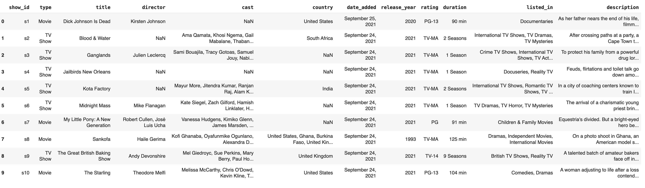
DATASET OVERVIEW
04

Slide 5



DATA CLEANING
DROPPED COLUMNS
MISSING VALUES
Cast
(Name of the Heroes act in the movie)
Description
(The description of the story)
Filled Country null values using forward fill (ffill).
Filled Date_added and Rating null values using mode.
Replaced missing durations with mode values (e.g., “90 min” for Movies).
05

Slide 6
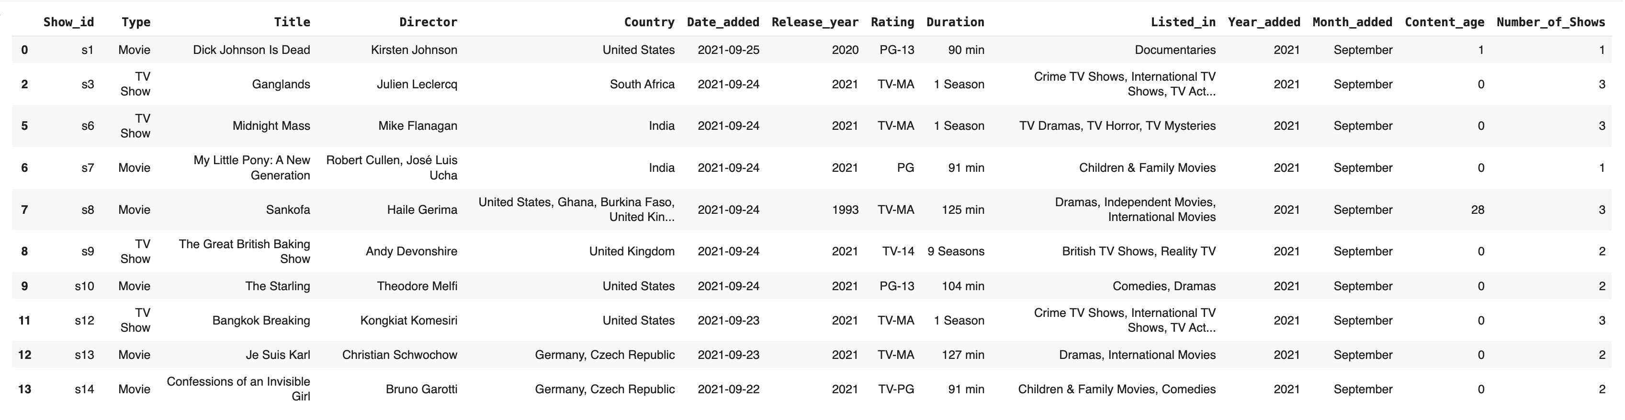
Final DATASET OVERVIEW
06

Slide 7
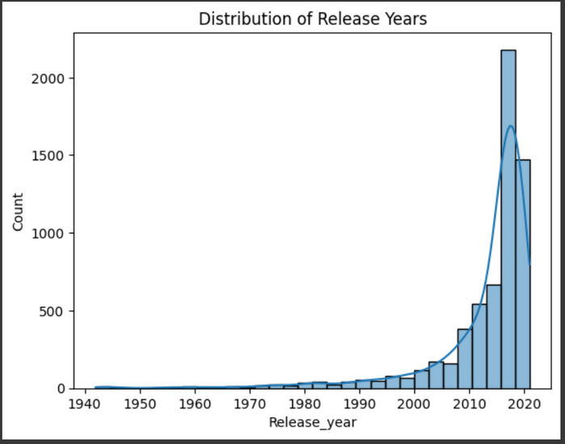
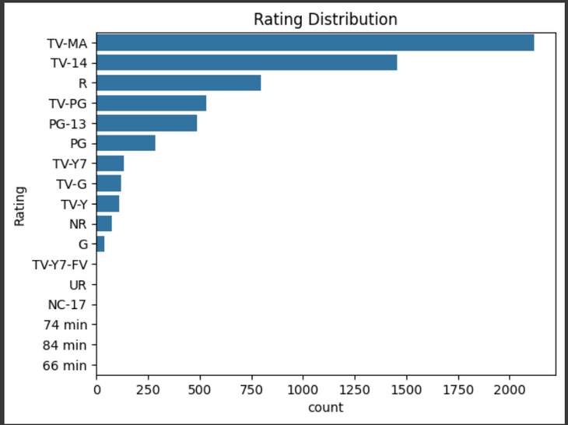
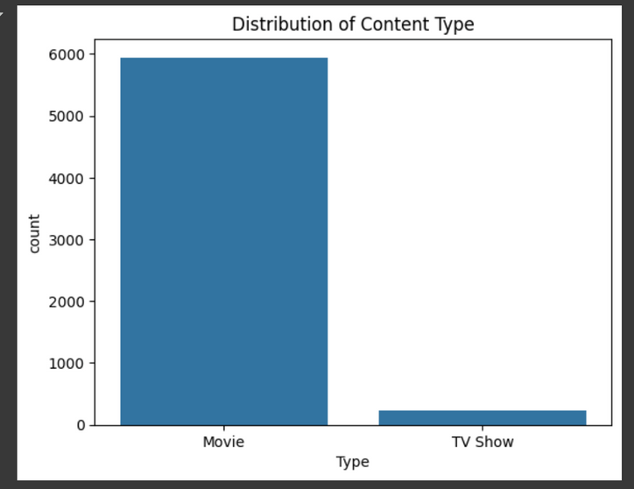
EXPLORATORY DATA ANALYSIS
UNIVARIATE ANALYSIS
histogram plot for Release year
Count plot for Rating
Count Plot for Content type
07

Slide 8
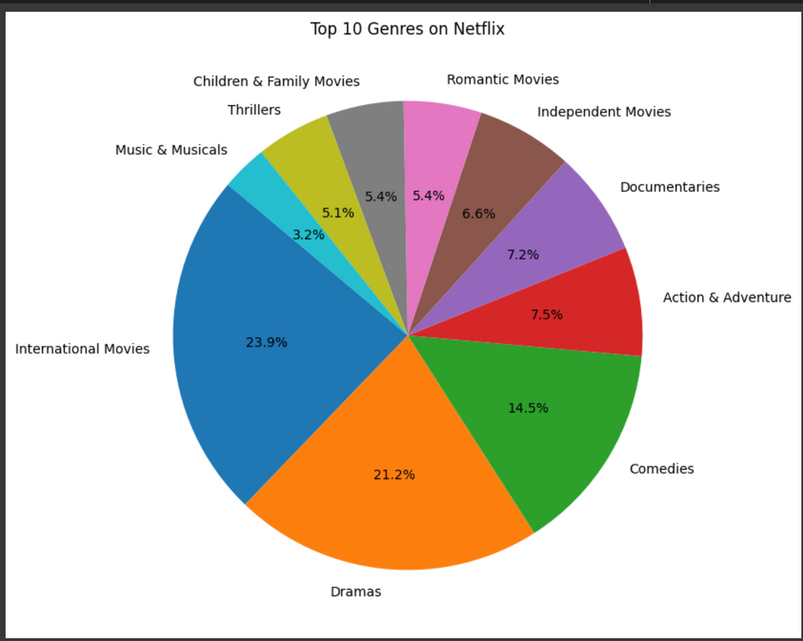
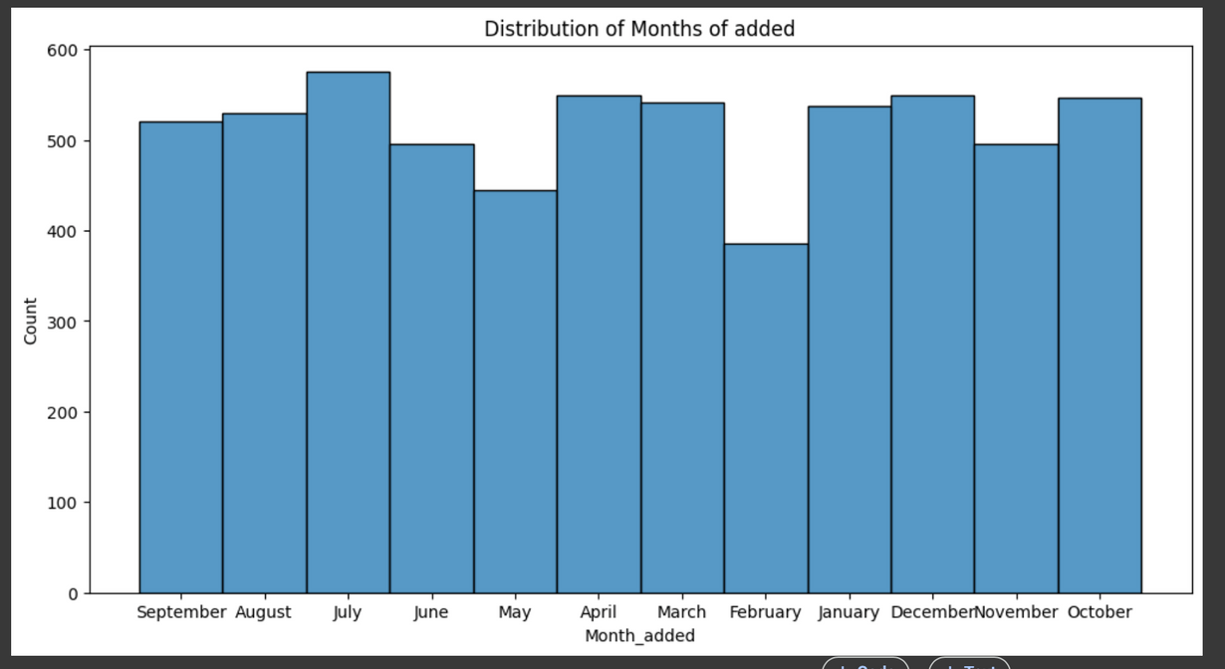
Histogram Plot for Months of added
Pie Chart for Geners
08

Slide 9
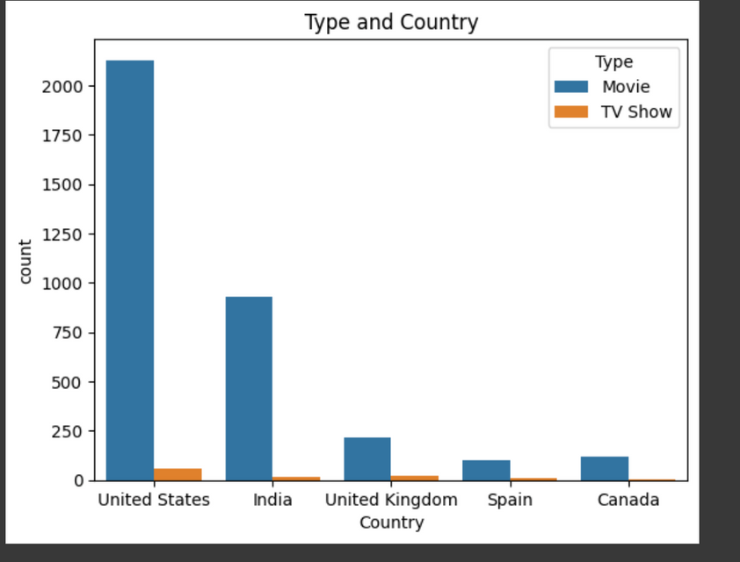
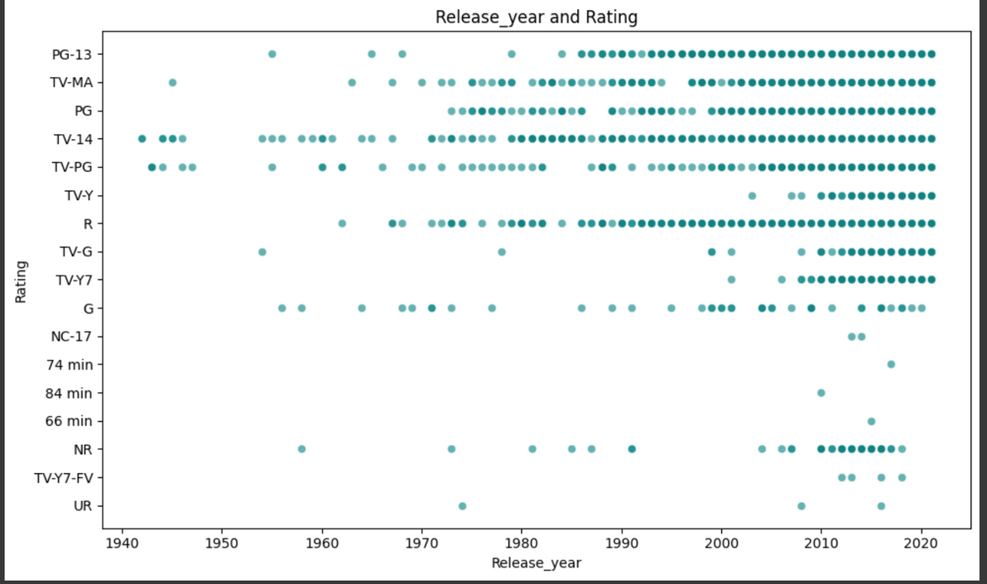
BIVARIATE ANALYSIS
09
Scatterplot
for Release year and Rating
Countplot
for Type and Country

Slide 10
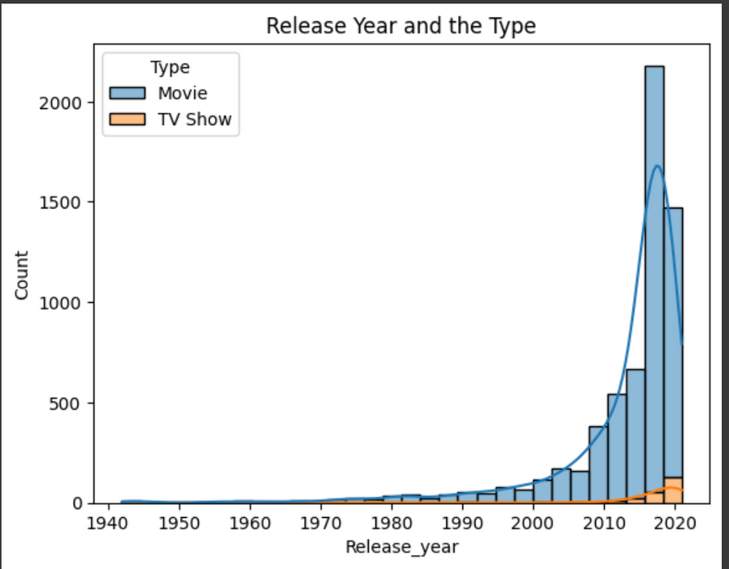
Count plot
for Release year and Type
10

Slide 11
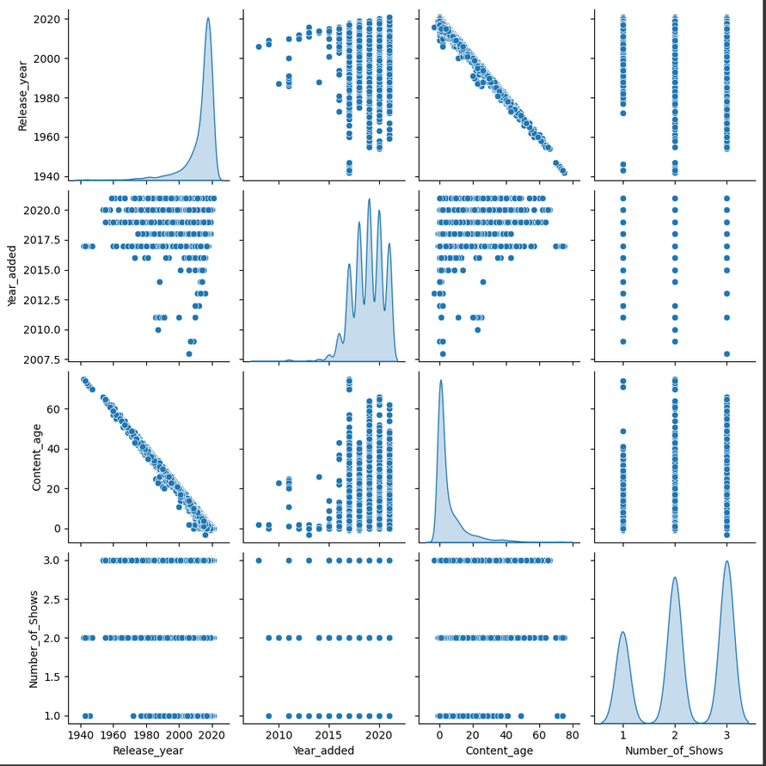
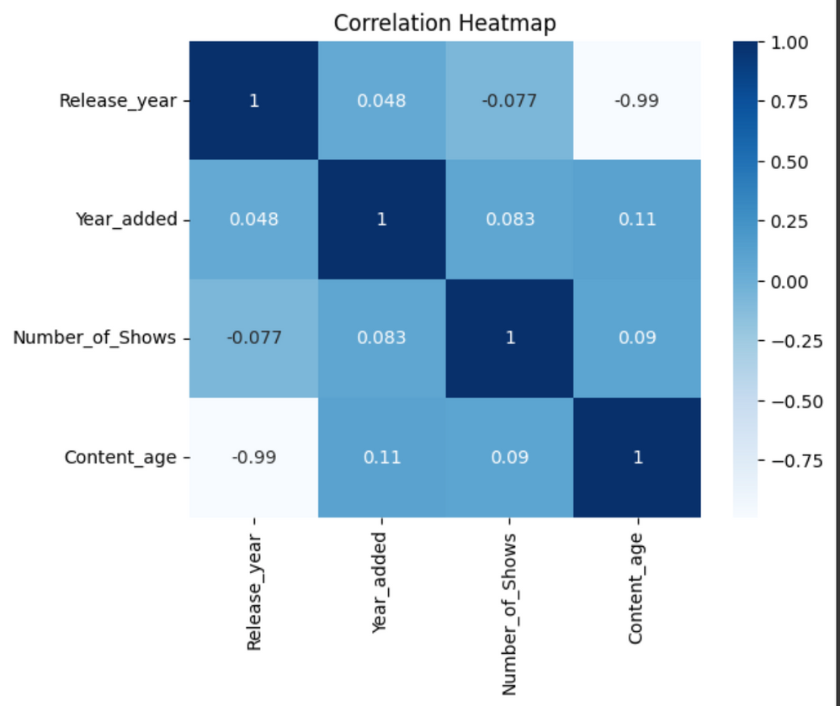
MULTIVARIATE ANALYSIS
11
HEATMAP
PAIRPLOT

Slide 12
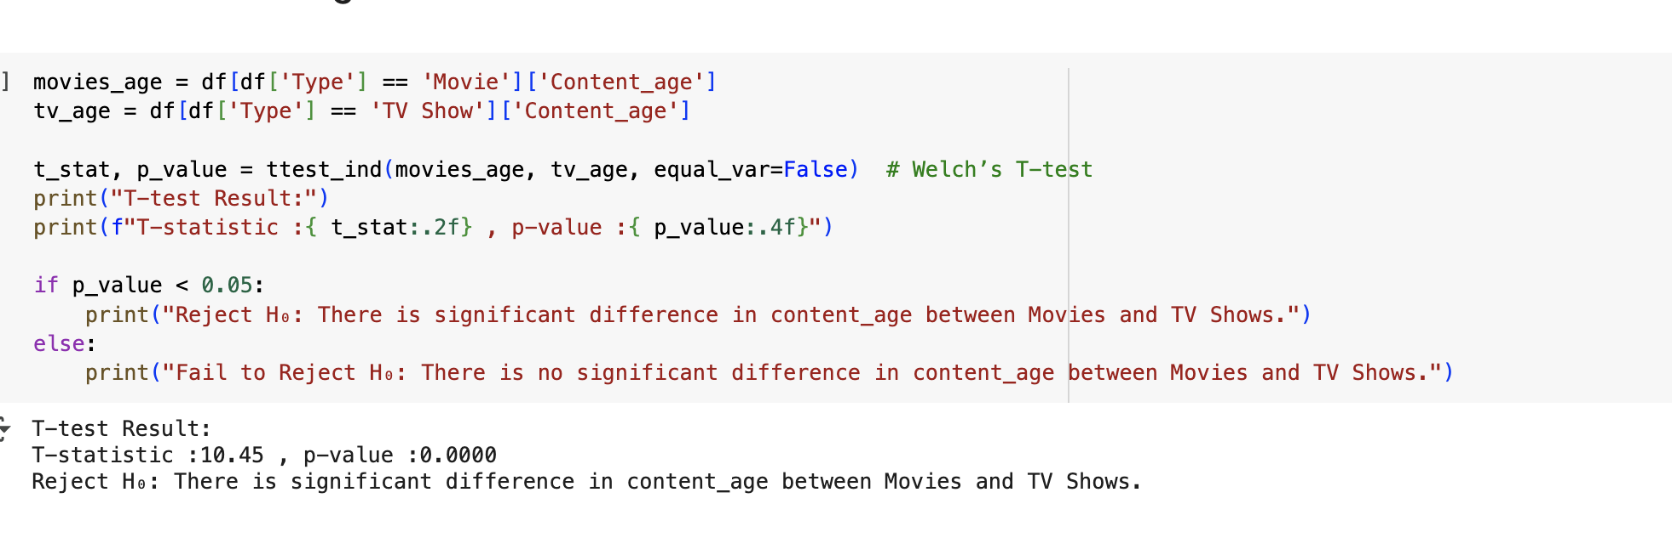
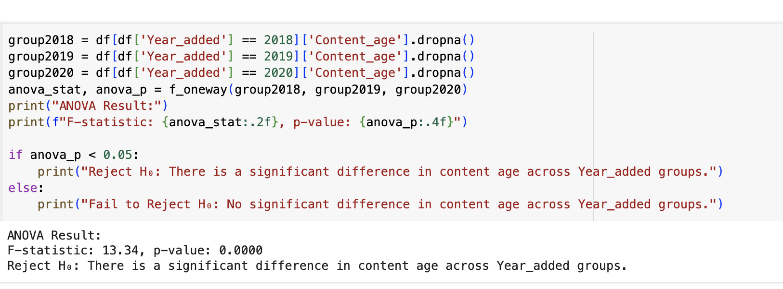
T-test between Types and content age
T-test: Shows significant differences in content age between Movies and TV Shows.
Anova test between Year added and Content age
The average content age (time gap between release and being added to Netflix) changed significantly between 2018, 2019, and 2020.
Possible reasons:
In 2020, Netflix started adding newer releases faster (lower content age).
12

Slide 13
Overall conclusion:
Movies dominate over TV Shows, but both have shown steady growth over the years
In 2015-2020 Netflix got high viewers comparing to others years
Ratings are mostly centered around TV-MA and TV-14, indicating a focus on mature audiences
Top genres include: International TV Shows, Dramas and Comedies
The United States leads in content contribution, followed by India, UK, and South Korea
13

Slide 14
THANK YOU
14

